Slide 1
AUDIO & AUDIO COMPRESSION
Dr. Quang Duc Tran

Slide 2
Sound Facts
Sound is a continuous wave that travels through the air. The wave is made up of pressure differences
Sound waves have normal wave properties (reflection, refraction, diffraction etc.)
Frequency represents the number of periods in a second and is measured in hertz (Hz) or cycles per second.
Amplitude is the measure of displacement of the air pressure wave from its means. It is related to but not the same as loudness.

Slide 3
Digital Audio
Audio signal that is encoded in digital form
Sampling
Quantization
Sampling rate
Telephone: 8 kHz
CD-audio: 44.1 kHz
Quantization
Speech: 8 bit
CD-audio: 16 bit
Number of soundtracks
Stereo: 2 channels
Professional: 16, 32 or more.

Slide 4
Digital Audio (Cont.)
Example 1: Sampling a four second sound of a speaking voice
Because the voice is in the lower range of the audio spectrum, we could sample the sound at 8 kHz with a mono channel and 8 bit resolution
Example 2: Sampling a four second sound of a musical selection
In order to capture the complex musical sound, the sampling rate should be 44.1 kHz. We will record a stereo sample with 16 bit resolution.

Slide 5
Audio Compression
Differential Pulse Code Modulation (DPCM)
Adaptive Differential Pulse Code Modulation (ADPCM)
Linear Predictive Coding (LPC)
Perceptual Coding
MPEG Audio Compression

Slide 6
DPCM
The range of differences in amplitudes between successive samples of the audio waveform is less than the range of the actual sample amplitudes. Hence, fewer bits to represent the difference signals.
Designing of DPCM is easy. Prediction is then based on the previously coded/transmitted samples.
Because the co-relation between successive are very good, so the output sample is far better than that of PCM.

Slide 7
DPCM (Cont.)
Speech
Input
Signal
AAF
ADC
Subtractor
Parallel-to-serial converter
Timing + Control
Register R
Adder
Network
Speech
Output
Signal
AAF
ADC
Register R
Adder
Serial-to-parallel converter
Timing + Control

Slide 8
DPCM (Cont.)
Encoder
Previous digitized sample is held in the register (R).
The DPCM signal is computed by subtracting the current content (R) from the new output by the ADC.
The register value is then updated before transmission.
Decoder
Decoder simply adds the previous register contents (PCM) with the DPCM.
Since ADC will have noise there will be cumulative errors in the value of the register signal.

Slide 9
Third-order predictive DPCM
Speech
Input
Signal
AAF
ADC
Subtractor
Parallel-to-serial converter
Adder
Timing + Control
C1
x
C2
x
C3
x
R1
R2
R3
Network
Speech
Output
Signal
AAF
ADC
Adder
Serial-to-parallel converter
Timing + Control
C1
x
C2
x
C3
x
R1
R2
R3

Slide 10
Third-order predictive DPCM (Cont.)
To eliminate the noise effect, predictive techniques are used to predict a more accurate version of the previous signal (i.e., using not only the current signal but also varying proportions of a number of the preceding estimated signals).
These proportions used are known as predictor coefficients.
Different signal is computed by subtracting varying proportion of the last three predicted values from the current output by the ADC

Slide 11
Third-order predictive DPCM (Cont.)
R1, R2, R3 will be subtracted from PCM.
The values in the R1 register will be transferred to R2 and R2 to R3 and the new predicted value goes into R1.
Decoder operates in a similar way by adding the same proportions of the last three computed PCM signals to the received DPCM signal.

Slide 12
Adaptive DPCM (ADPCM)
Saving of bandwidth is possible by varying the number of bits used for the difference signal depending on its amplitude.
An international standard for this is defined in ITU-T Recommendation G.721.
The principle is similar to that of DPCM except an eight-order predictor is used and the number of bits used to quantize each difference is varied.
Larger step-size is used to encode differences between high frequency samples and smaller step-size for differences between low frequency samples.

Slide 13
Sub-band ADPCM
Lower sub-band bandlimiting filter (50Hz-3.5 kHz)
Lower sub-band ADPCM encoder
48 kbps
Multiplexer
Speech
Input
Signal
Upper sub-band bandlimiting filter (3.5kHz-7kHz)
Upper sub-band ADPCM encoder
16 kbps
Network
Lower sub-band low-pass filter (50Hz-3.5 kHz)
Lower sub-band ADPCM decoder
48 kbps
Demultiplexer
Speech
Output
Signal
Upper sub-band low-pass filter (3.5kHz-7kHz)
Upper sub-band ADPCM decoder
16 kbps

Slide 14
Sub-band ADPCM
The sub-band ADPCM is defined in ITU-T Recommendation G.722 (better sound quality in VoIP).
This uses sub-band coding, in which the input signal prior to sampling is passed through two filters: one which passes only signal frequencies in the range 50 Hz through to 3.5 kHz and the other only frequencies in the range 3.5 kHz through to 7 kHz.
Each is then sampled and encoded independently using ADPCM. 6 digits are used to encode the lower sub-band signal, while 2 digits are used to encode the upper sub-band signal.

Slide 15
Linear Predictive Coding
Linear Predictive Coding derives its name from the fact that current speech sample can be closely approximated as a linear combination of past samples. The approximation is done on short chucks of the speech signal, called frames. Generally 30 to 50 frames per second give intelligible speech with good compression.
Order of the model
Prediction coefficient
Previous speech samples
Prediction error

Slide 16
Linear Predictive Coding (Cont.)
The predictor coefficients are determined by minimizing the sum of squared differences (over a finite interval) between the actual speech samples and the linearly predicted ones.
The higher the coefficient order p, the closer the approximation is.
Uncompressed speech is transmitted at 64 kbps. The LPC transmits speech at a bit rate of 2.4 kbps. There is a noticeable loss of quality, however, the speech is still audible.
LPC is used by phone companies (e.g., GSM standard).

Slide 17
Code-excited LPC (CELPC)
In CELPC model instead of treating each digitized frame independently for encoding purposes, just a limited set of frames are used, each known as a wave template.
A pre-computed set of templates are held by the encoder and the decoder in what is known as the template codebook.
Each of the individual digitized samples that make up a particular template in the codebook are differently encoded.

Slide 18
Perceptual Coding
LPC and CELPC are used for telephony applications. PC is designed for compression of general audio associated with a digital television broadcast.
Sampled frames of the source audio waveform are analyzed – but only those features that are perceptible to the ear are transmitted.
Although the human ear is sensitive to signals in the range 15 Hz to 20 kHz, the level of sensitivity to each signal is non-linear, i.e., the ear is more sensitive to some signals than others.

Slide 19
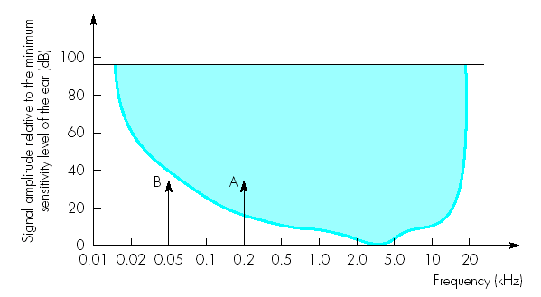
Sensitivity of the ear
Sensitivity of the ear varies with the frequency of the signal. The ear is most sensitive to signals in the range 2-5 kHz
The dynamic range of ear is defined as the loudest sound it can hear to the quietest sound.
Signal A is above the hearing threshold and B is below the hearing threshold

Slide 20
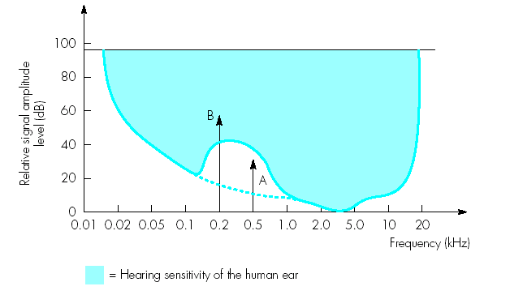
Frequency Masking
When multiple signals are present, a strong signal may reduce the level of sensitivity of the ear to other signals which are near to it in frequency
Signal B is larger than signal A. This causes the basic sensitivity curve to be distorted.
Signal A will no longer be heard as it is within the distortion band.

Slide 21
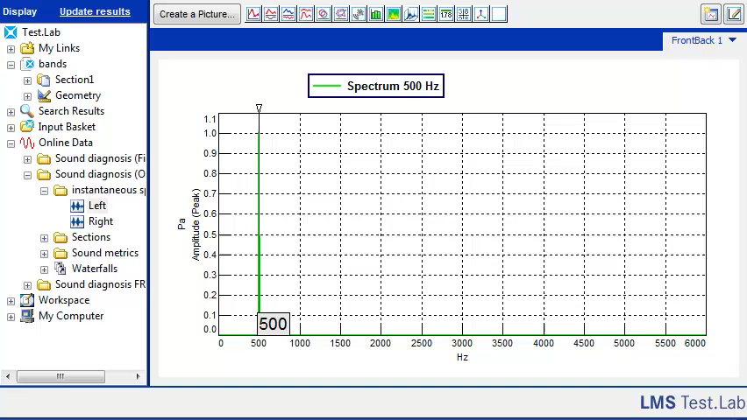
Critical band
Critical bands are used to quantify the ability of the human ear to distinguish between individual signals.
At low frequencies, the human ear can distinguish changes in low frequency more easily than at high frequencies. For examples, the ear can distinguish a 20Hz difference between 500 and 520Hz tones more readily than a 5000 and 5020Hz tones.

Slide 22
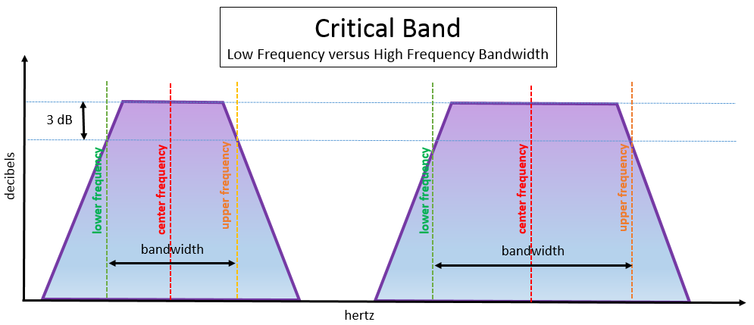
Critical band
The critical bandwidths are defined in a similar manner to bandpass filters, with a center frequency and a bandwidth. The bandwidth has a lower and upper frequency, defined by the point where there is a 3dB roll off.

Slide 23
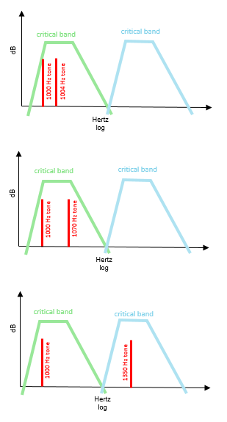
Critical band
Human hearing can distinguish separate tones when they are in different critical bands. When tones are in the same critical band the ear perceives a modulation or beating.
Beating phenomenon occurs because the ear cannot resolve inputs whose frequency difference is smaller than the bandwidth of the critical band.

Slide 24
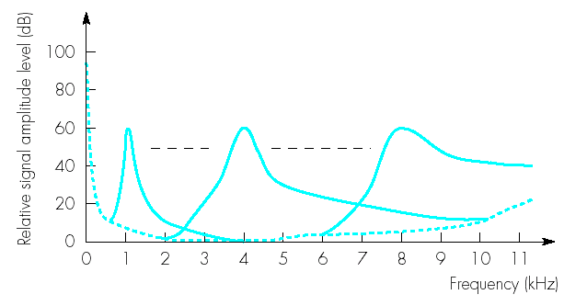
Frequency Masking (Cont.)
If the magnitude of the frequency components that make up an audio sound can be determined, it is possible to determine those frequencies that will be masked and do not need to be transmitted.
The width of each curve at a particular signal level is known as the critical bandwidth for that frequency.

Slide 25
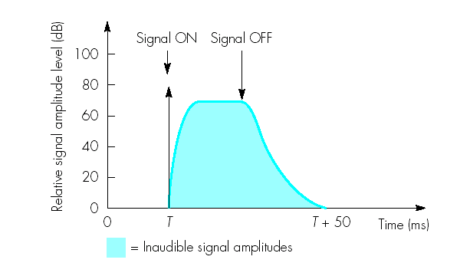
Temporal Masking
During this time, signals whose amplitudes are less than the decay envelope will not be heard and hence need not be transmitted.
After the ear hears a loud sound, it takes a further short time before it can hear a quieter sound. This is known as the temporal masking.

Slide 26
MPEG Audio Coder
Masking Threshold
Signal-to-mask ratios + Bit allocations
….…..
…...........
PCM
Encoder
1
Analysis filter bank (DFT)
Q1
Format frame for transmission
2
Q2
Speech
Input
Signal
…………………
…………………
…..…………..
32
Q32

Slide 27
MPEG Audio Coder (Cont.)
The bandwidth available for transmission is divided into 32 frequency sub-bands using a bank of analysis filters.
Processing associated with both frequency and temporal masking is carried out by the psychoacoustic model. A set of signal-to-mask ratios (SMR) is determined. This indicates the frequency components whose amplitude is below the audible components.
More bits are assigned for highest sensitivity regions compared with less sensitivity regions.

